Slide 1
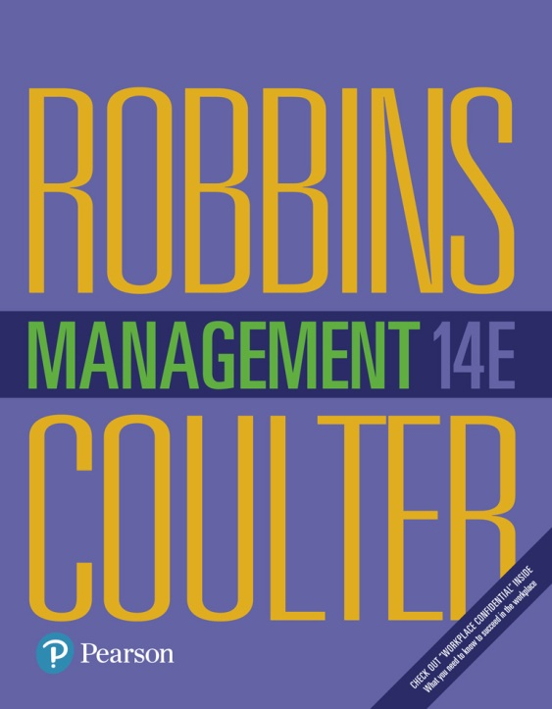
Management
Fourteenth Edition
Chapter 7
Managing Change and Disruptive Innovations
Copyright © 2018, 2016, 2014 Pearson Education, Inc. All Rights Reserved

Slide 2
Learning Objectives
7.1 Describe making the case for change.
7.2 Compare and contrast views on the change process.
7.3 Classify areas of organizational change.
7.4 Explain how to manage change.
Know how to be change ready by overcoming your resistance to change.
7.5 Discuss contemporary issues in managing change.
Develop your skill in change management so you can serve as a catalyst for change.
7.6 Describe techniques for stimulating innovation.
7.7 Explain why managing disruptive innovation is important.

Slide 3
The Case for Change
Organizational change: any alteration of people, structure, or technology in an organization
Change agent: someone who acts as a catalyst and assumes the responsibility for managing the change process
Notes:
Most managers, at one point or another, will have to change some things in their workplace. We classify these changes as organizational change, which is any alteration of people, structure, or technology.
Organizational changes need someone to act as a catalyst and assume the responsibility for managing the change process, as our opener described—that is a change agent. Change agents can be a manager within the organization but could also be a nonmanager—for example, a change specialist from the human resources department or even an outside consultant.
For major changes, an organization often hires outside consultants to provide advice and assistance. Because they’re from the outside, they can provide an objective perspective that insiders may lack

Slide 4
Exhibit 7-1 External and Internal Forces for Change
External | Internal
Changing consumer needs and wants | New organizational strategy
New governmental laws | Change in composition of workforce
Changing technology | New equipment
Economic changes | Changing employee attitudes
Notes:
Change is an organizational reality. Organizations face change because external and internal factors create the forces for change (see Exhibit 7-1).
Let’s review major external and internal factors associated with change.

Slide 5
External Factors
Changing consumer needs and wants
New governmental laws
Changing technology
Economic changes
Notes:
Ford Motor Company understands the importance of being responsive to its customers. The company’s experiments will also enable them to attract a new breed of customers, helping to secure the company’s future. But sometimes a company may make changes that fail to meet customer preferences.
Government laws require changes in how managers must conduct business. Five broad categories of governmental laws include truth- in-advertising, employment and labor fair practices, environmental protection, privacy, and safety and health.
What do the Chevrolet Volt and the Tesla Motors Model S have in common? Both are examples of electric-powered vehicles. Compared to gas-powered vehicles, electric cars have shorter driving ranges; however, ongoing research and development into improving battery capacity to extend their range is a high priority.
Managers must respond to changes in economic forces. Consider the impact of an economic recession. According to the U.S. Bureau of Labor Statistics, recessions are characterized by a general slowdown in economic activity, a downturn in the business cycle, and a reduction in the amount of goods and services produced and sold. The so-called Great Recession (2007–2009) was considered to be one of the more severe recessions felt worldwide.

Slide 6
Internal Factors
New organizational strategy
Change in composition of workforce
New equipment
Changing employee attitudes
Notes:
For decades, Walgreens’ strategy focused on increasing its number of retail stores. The costs of maintaining so many stores are substantial, putting downward pressures on profit levels. Company management reconsidered its strategy of adding stores. In its place, the company refocused its strategy to improving the customer service experience and providing more competitive product pricing.
Through the decades, the U.S. workforce has become more diverse. A key challenge entails orchestrating these differences to maintain an inclusive culture that focuses on productivity.
More and more companies are using 3D printers to create product prototypes. Technological changes are particularly making their marks on health care. These technologies include advances in genomics, biotechnology, robotics, connected care, and artificial intelligence. Advances in robotic technology, for example, is changing how surgeons perform some surgical procedures.
A recent survey revealed that the attitudes of employees at organizations going through significant changes tend to be less favorable than at more stable companies. But, not all employees in changing organizations have less favorable attitudes. Those who prefer stability are less likely to try new technology or embrace change than employees who are open to change.

Slide 7
Calm Waters Versus White-Water Rapids Metaphors
Calm waters metaphor:
Unfreezing the status quo
Changing to a new state
Refreezing to make the change permanent
Notes:
According to Kurt Lewin, successful change can be planned and requires unfreezing the status quo, changing to a new state, and refreezing to make the change permanent. The status quo is considered equilibrium. To move away from this equilibrium, unfreezing is necessary. Unfreezing can be thought of as preparing for the needed change. It can be done by increasing the driving forces, which are forces pushing for change; by decreasing the restraining forces, which are forces that resist change; or by combining the two approaches.
Once unfreezing is done, the change itself can be implemented. However, merely introducing change doesn’t ensure that it will take hold. The new situation needs to be refrozen so that it can be sustained over time. Unless this last step is done, there’s a strong chance that employees will revert back to the old equilibrium state—that is, the old ways of doing things.

Slide 8
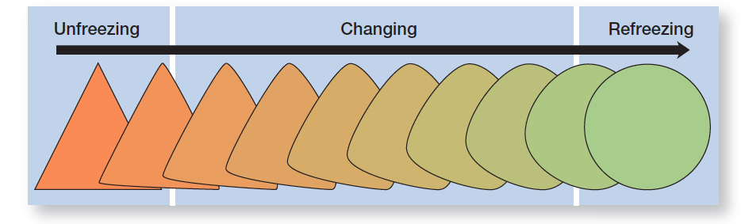
Exhibit 7-2 The Three-Step Change Process
Exhibit 7-2 illustrates Kurt Lewin’s three-step change process.
Notes:
Lewin’s three-step process treats change as a move away from the organization’s current equilibrium state. It’s a calm waters scenario where an occasional disruption (a “storm”) means planning and implementing change to deal with the disruption. Once the disruption has been dealt with, however, things continue on under the new changed situation. This type of environment isn’t what most managers face today.

Slide 9
White-Water Rapids Metaphor
White-water rapids metaphor: the lack of environmental stability and predictability requires that managers and organizations continually adapt and manage change actively to survive
Notes:
The stability and predictability of the calm waters metaphor don’t exist. Disruptions in the status quo are not occasional and temporary, and they are not followed by a return to calm waters. Many managers never get out of the rapids.
Although you’d expect a chaotic and dynamic environment in high-tech industries, even organizations in non-high-tech industries are faced with constant change.
Today, any organization that treats change as the occasional disturbance in an otherwise calm and stable world runs a great risk. Too much is changing too fast for an organization or its managers to be complacent.

Slide 10
Reactive Versus Proactive Change Processes
Reactive: reacting to a situation that has occurred
Proactive: acting in advance of a situation
Notes:
We can find these same patterns in organizations. The civil aviation authorities illustrate a reactive change process in direct response to the Germanwings crash, and the Ford Motor Company’s experiments describe a proactive change process.

Slide 11
Exhibit 7-3 Four Types of Change
Exhibit 7-3 shows the four main areas of change managers face.
Notes:
Changing strategy signifies a change in how managers ensure the success of the company.
Changing structure includes any change in structural variables such as reporting relationships, coordination mechanisms, employee empowerment, or job redesign.
Changing technology encompasses modifications in the way work is performed or the methods and equipment that are used.
Changing people refers to changes in attitudes, expectations, perceptions, and behavior of individuals or groups.

Slide 12
Types of Change: Strategy
Failure to change strategy when circumstances dictate could undermine a company’s success.

Slide 13
Types of Change: Structure
Changing structural components
Changing structural design
Notes:
Changes in the external environment or in organizational strategies often lead to changes in the organizational structure.
Because an organization’s structure is defined by how work gets done and who does it, managers can alter one or both these structural components.
Another option would be to make major changes in the actual structural design.

Slide 14
Types of Change: Technology
New equipment, tools, or methods
Automation
Computerization
Notes:
Today, technological changes usually involve the introduction of new equipment, tools, or methods; automation; or computerization.
Assembly workers in Ford’s Valencia, Spain, manufacturing facility wear a small device on their wrists that enables them to ensure that vehicle specifications are correct. According to Ford of Europe’s manufacturing vice president, “The ability to simply consult a smartphone screen to check any aspect of a vehicle’s quality and specification helps to guarantee highest levels of product quality, and improves work processes and manufacturing efficiency.”
Automation is a technological change that replaces certain tasks done by people with tasks done by machines. Robotic technology has been incorporated in many business settings.
The most visible technological changes have come from computerization. Most organizations have sophisticated information systems.

Slide 15
Types of Change: People
Organizational development: change methods that focus on people and the nature and quality of interpersonal work relationships
Notes:
Changing people involves changing attitudes, expectations, perceptions, and behaviors—something that’s not easy to do. Organizational development (OD) is the term used to describe change methods that focus on people and the nature and quality of interpersonal work relationships.
Managers need to recognize that some techniques that work for U.S. organizations may not be appropriate for organizations or organizational divisions based in other countries.

Slide 16
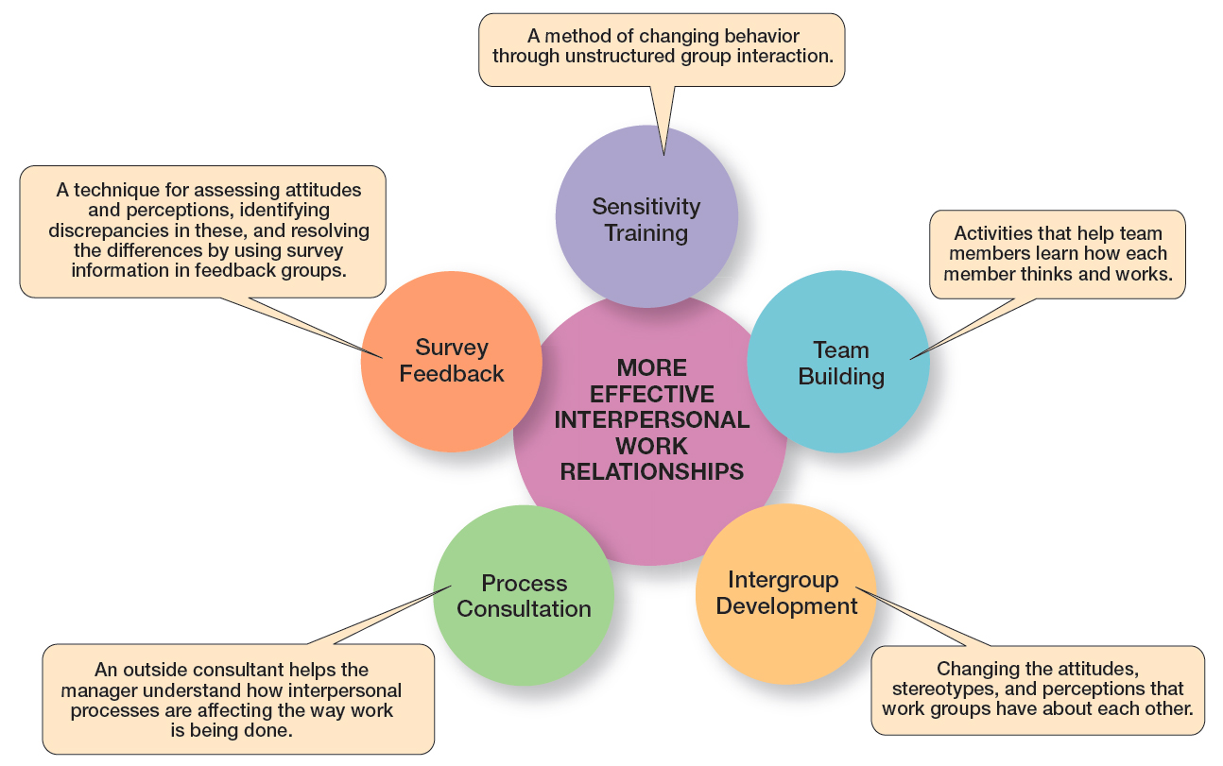
Figure 7-4 Popular OD Techniques
The most popular OD techniques are described in Exhibit 7-4
Notes:
The most popular OD techniques are described in Exhibit 7-4.

Slide 17
Why Do People Resist Change?
Uncertainty
Habit
Fear of loss
Belief change is inconsistent with goals of organization
Notes:
Why do people resist change? The main reasons include uncertainty, habit, concern over personal loss, and the belief that the change is not in the organization’s best interest. Change replaces the known with uncertainty. Another cause of resistance is that we do things out of habit. The third cause of resistance is the fear of losing something already possessed. Change threatens the investment you’ve already made in the status quo. A final cause of resistance is a person’s belief that the change is incompatible with the goals and interests of the organization.

Slide 18
Techniques for Reducing Resistance to Change?
Education and communication
Participation
Facilitation and support
Negotiation
Manipulation and co-optation
Coercion
Notes:
Several strategies have been suggested in dealing with resistance to change. These approaches include education and communication, participation, facilitation and support, negotiation, manipulation and co-optation, and coercion.
Education and communication can help reduce resistance to change by helping employees see the logic of the change effort. This technique, of course, assumes that much of the resistance lies in misinformation or poor communication.
Participation involves bringing those individuals directly affected by the proposed change into the decision-making process. Their participation allows these individuals to express their feelings, increase the quality of the process, and increase employee commitment to the final decision.
Facilitation and support involve helping employees deal with the fear and anxiety associated with the change effort. This help may include employee counseling, therapy, new skills training, or a short paid leave of absence.
Negotiation involves exchanging something of value for an agreement to lessen the resistance to the change effort. This resistance technique may be quite useful when the resistance comes from a powerful source.
Manipulation and co-optation refer to covert attempts to influence others about the change. It may involve distorting facts to make the change appear more attractive.
Finally, coercion can be used to deal with resistance to change. Coercion involves the use of direct threats or force against the resisters.

Slide 19
Exhibit 7-5 Techniques for Reducing Resistance to Change
Technique | When Used | Advantage | Disadvantage
Education and communication | When resistance is due to misinformation | Clear up misunderstandings | May not work when mutual trust and credibility are lacking
Participation | When resisters have the expertise to make a contribution | Increase involvement and acceptance | Time-consuming; has potential for a poor solution
Facilitation and support | When resisters are fearful and anxiety ridden | Can facilitate needed adjustments | Expensive; no guarantee of success
Negotiation | When resistance comes from a powerful group | Can “buy” commitment | Potentially high cost; opens doors for others to apply pressure too
Manipulation and co-optation | When a powerful group’s endorsement is needed | Inexpensive, easy way to gain support | Can back re, causing change agent to lose credibility
Coercion | When a powerful group’s endorsement is needed | Inexpensive, easy way to gain support | May be illegal; may undermine change agent’s credibility
Notes:
When managers see resistance to change as dysfunctional, what can they do? Several strategies have been suggested in dealing with resistance to change. These approaches include education and communication, participation, facilitation and support, negotiation, manipulation and co-optation, and coercion. These tactics are summarized and described in Exhibit 7-5.

Slide 20
Leading Change
Managers can make change happen successfully by:
making organization change capable
understanding their own role in process
giving employees a role in the change
Notes:
What does it take to be a change-capable organization? Exhibit 7-6 summarizes the characteristics.
The second component of making change happen successfully is for managers to recognize their own important role in the process. Managers can, and do, act as change agents. But their role in the change process includes more than being catalysts for change; they must also be change leaders.
The final aspect of making change happen successfully revolves around getting all organizational members involved. Successful organizational change is not a one- person job. Individual employees are a powerful resource in identifying and addressing change issues. Managers need to encourage employees to be change agents—to look for those day-to-day improvements and changes that individuals and teams can make.

Slide 21
Exhibit 7-6 Change-Capable Organizations
Characteristics
Link the present and the future. Think of work as more than an extension of the past; think about future opportunities and issues and factor them into today’s decisions.
Make learning a way of life. Change-friendly organizations excel at knowledge sharing and management.
Actively support and encourage day-to-day improvements and changes. Successful change can come from the small changes as well as the big ones.
Ensure diverse teams. Diversity ensures that things won’t be done like they’ve always been done.
Encourage mavericks. Because their ideas and approaches are outside the mainstream, mavericks can help bring about radical change.
Shelter breakthroughs. Change-friendly organizations have found ways to protect those breakthrough ideas.
Integrate technology. Use technology to implement changes.
Build and deepen trust. People are more likely to support changes when the organization’s culture is trusting and managers have credibility and integrity.
Couple permanence with perpetual change. Because change is the only constant, companies need to figure out how to protect their core strengths during times of change.
Support an entrepreneurial mindset. Many younger employees bring a more entrepreneurial mindset to organizations and can serve as catalysts for radical change.
Notes:
What does it take to be a change-capable organization? Exhibit 7-6 summarizes the characteristics.

Slide 22
Creating a Culture for Change
The fact that an organization’s culture is made up of relatively stable and permanent characteristics tends to make it very resistant to change.
Notes:
A culture takes a long time to form, and once established it tends to become entrenched. Strong cultures are particularly resistant to change because employees have become so committed to them.

Slide 23
Understanding the Situational Factors
Conditions that facilitate change:
dramatic crisis occurs
leadership changes hands
culture is weak
Notes:
What “favorable conditions” facilitate cultural change?

Slide 24
Exhibit 7-7 Changing Culture
Strategies for Managing Cultural Change
Set the tone through management behavior; top managers, particularly, need to be positive role models.
Create new stories, symbols, and rituals to replace those currently in use.
Select, promote, and support employees who adopt the new values.
Redesign socialization processes to align with the new values.
To encourage acceptance of the new values, change the reward system.
Replace unwritten norms with clearly specified expectations.
Shake up current subcultures through job transfers, job rotation, and/or terminations.
Work to get consensus through employee participation and creating a climate with a high level of trust.
Notes:
If conditions are right, how do managers change culture? No single action is likely to have the impact necessary to change something ingrained and highly valued. Managers need a strategy for managing cultural change, as described in Exhibit 7-7.

Slide 25
Employee Stress
Stress: the adverse reaction people have to excessive pressure placed on them from extraordinary demands, constraints, or opportunities
Stressors: factors that cause stress
Notes:
An uncertain environment characterized by time pressures, increasing workloads, mergers, and restructuring has created a large number of employees who are overworked and stressed. In fact, depending on which survey you look at, the number of employees experiencing job stress in the United States ranges anywhere from 40 percent to 80 percent.
Stress can be caused by personal factors and by job-related factors called stressors. Clearly, change of any kind—personal or job-related—has the potential to cause stress because it can involve demands, constraints, or opportunities.

Slide 26
What Causes Stress?
Task demands
Role demands
Role conflicts
Role overload
Role ambiguity
Interpersonal demands
Organization structure
Organizational leadership
Notes:
Task demands are factors related to an employee’s job. They include the design of a person’s job (autonomy, task variety, degree of automation), working conditions, and the physical work layout.
Role demands relate to pressures placed on an employee as a function of the particular role he or she plays in the organization. Role conflicts create expectations that may be hard to reconcile or satisfy. Role overload is experienced when the employee is expected to do more than time permits. Role ambiguity is created when role expectations are not clearly understood and the employee is not sure what he or she is to do.
Interpersonal demands are pressures created by other employees. Lack of social support from colleagues and poor interpersonal relationships can cause considerable stress, especially among employees with a high social need.
Organization structure can increase stress. Excessive rules and an employee’s lack of opportunity to participate in decisions that affect him or her are examples of structural variables that might be potential sources of stress.
Organizational leadership represents the supervisory style of the organization’s managers. Some managers create a culture characterized by tension, fear, and anxiety.

Slide 27
Personal Factors
Type A personality: people who have a chronic sense of urgency and an excessive competitive drive
Type B personality: people who are relaxed and easygoing and accept change easily
Notes:
Until quite recently, it was believed that Type As were more likely to experience stress on and o the job. A closer analysis of the evidence, however, has produced new conclusions. Studies show that only the hostility and anger associated with Type A behavior are actually associated with the negative effects of stress. And Type Bs are just as susceptible to the same anxiety-producing elements.

Slide 28
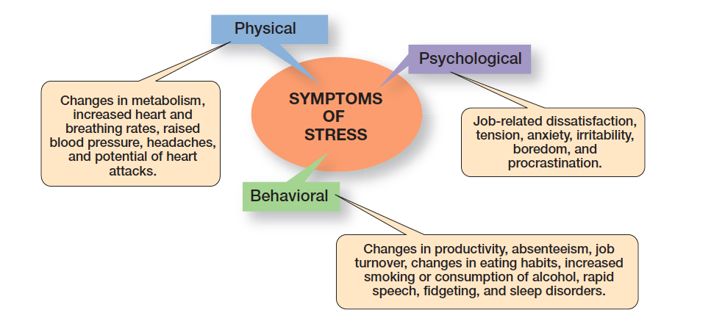
Figure 7-8 Symptoms of Stress
As Exhibit 7-8 shows, stress symptoms can be grouped under three general categories: physical, psychological, and behavioral.
Notes:
As Exhibit 7-8 shows, stress symptoms can be grouped under three general categories: physical, psychological, and behavioral. All of these can significantly affect an employee’s work.
We see stress in a number of ways. For instance, an employee who is experiencing high stress may become depressed, accident prone, or argumentative; may have difficulty making routine decisions; may be easily distracted; and so on. Employees in companies where downsizing is occurring tend to get ill at twice the rate of employees whose jobs are secure.

Slide 29
How Can Stress Be Reduced?
Realistic job preview during selection process
Performance planning program, e.g. MBO
Job redesign
Addressing personal stress
counseling
time management programs
wellness programs
Notes:
Because stress can never be totally eliminated from a person’s life, managers want to reduce the stress that leads to dysfunctional work behavior. How? Through controlling certain organizational factors to reduce job-related stress, and to a more limited extent, offering help for personal stress.
Things managers can do in terms of job-related factors begin with employee selection. Managers need to make sure an employee’s abilities match the job requirements. When employees are in over their heads, their stress levels are typically high. Similarly, a performance planning program such as MBO (management by objectives) will clarify job responsibilities, provide clear performance goals, and reduce ambiguity through feedback. Job redesign is also a way to reduce stress. If stress can be traced to boredom or to work overload, jobs should be redesigned to increase challenge or to reduce the workload.
Stress from an employee’s personal life raises two problems. First, it’s difficult for the manager to control directly. Second, ethical considerations include whether the manager has the right to intrude—even in the most subtle ways—in an employee’s personal life.

Slide 30
Creativity Versus Innovation
Creativity: the ability to combine ideas in a unique way or to make unusual associations between ideas
Innovation: taking creative ideas and turning them into useful products or work methods
Notes:
The definition of innovation varies widely, depending on who you ask. For instance, the Merriam-Webster dictionary defines innovation as “the introduction of something new” and “a new idea, method, or device; novelty.” The CEO of the company that makes Bubble Wrap says, “It means inventing a product that has never existed.” To the CEO of Ocean Spray Cranberries, it means “turning an overlooked commodity, such as leftover cranberry skins into a consumer snack like Craisins.

Slide 31
Stimulating and Nurturing Innovation
An environment that stimulates innovation includes three variables: the organization’s structure, culture, and human resource practices.

Slide 32
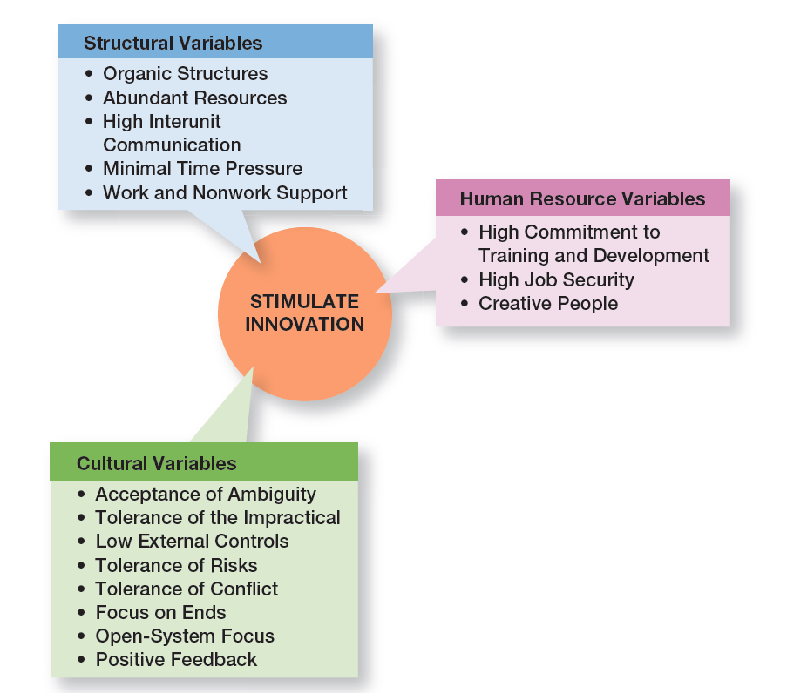
Figure 7-9 Innovation Variables
Exhibit 7-9 shows the three variables in an environment that stimulates innovation.
Notes:
But having creative people isn’t enough. It takes the right environment to help transform those inputs into innovative products or work methods. This “right” environment—that is, an environment that stimulates innovation—includes three variables: the organization’s structure, culture, and human resource practices (see Exhibit 7-9).

Slide 33
Structural Variables
Organic structures
Abundant resources
High interunit communication
Minimal time pressure
Work and nonwork support
Notes:
An organization’s structure can have a huge impact on innovativeness. Research into the effect of structural variables on innovation shows five things.
First, an organic-type structure positively influences innovation. Because this structure is low in formalization, centralization, and work specialization, it facilitates the flexibility and sharing of ideas that are critical to innovation.
Second, the availability of plentiful resources provides a key building block for innovation.
Third, frequent communication between organizational units helps break down barriers to in novation. Cross-functional teams, task forces, and other such organizational designs facilitate interaction across departmental lines and are widely used in innovative organizations.
Fourth, innovative organizations try to minimize extreme time pressures on creative activities despite the demands of white-water rapids environments. Although time pressures may spur people to work harder and may make them feel more creative, studies show that it actually causes them to be less.
Finally, studies have shown that an employee’s creative performance was enhanced when an organization’s structure explicitly supported creativity. Beneficial kinds of support included things such as encouragement, open communication, readiness to listen, and useful feedback.

Slide 34
Cultural Variables
Acceptance of ambiguity
Tolerance of the impractical
Low external controls
Tolerance of risks
Tolerance of conflict
Focus on ends
Open-system focus
Positive feedback
Notes:
Innovative organizations tend to have similar cultures. They encourage experimentation, set creativity goals, reward both successes and failures, and celebrate mistakes.
An innovative organization is likely to have the characteristics cited on the slide.

Slide 35
Human Resource Variables
Idea champion: individual who actively and enthusiastically supports new ideas, builds support, overcomes resistance, and ensures that innovations are implemented
Notes:
In this category, we find that innovative organizations actively promote the training and development of their members so their knowledge remains current; offer their employees high job security to reduce the fear of getting red for making mistakes; and encourage individuals to become idea champions.

Slide 36
Innovation and Design Thinking
When a business approaches innovation with a design-thinking mentality, the emphasis is on getting a deeper understanding of what customers need and want.
Notes:
Just as TQM provides a process for improving quality throughout an organization, design thinking can provide a process for coming up with things that don’t exist.
A design-thinking mentality also entails knowing customers as real people with real problems—not just as sales targets or demographic statistics. But it also entails being able to convert those customer insights into real and usable products.

Slide 37
Disruptive Innovation Definition
Disruptive innovation: innovations in products, services, or processes that radically change an industry’s rules of the game
Sustaining innovation: small and incremental changes in established products rather than dramatic breakthroughs
Notes:
Although the term “disruptive innovation” is relatively new, the concept isn’t. For instance, economist Joseph Shumpeter used the term “creative destruction” more than 70 years ago to describe how capitalism builds on processes that destroy old technologies but replaces them with new and better ones. That, in essence, is disruptive innovation.
In practice, disruptive innovation has been around for centuries. Vanderbilt’s railroads disrupted the sailing-ship business. Alexander Bell’s telephone rang the death-knell for Western Union’s telegraphy. Ford and other automobile builders destroyed horse-drawn-buggy manufacturers.

Slide 38
Exhibit 7-10 Examples of Past Disruptive Innovators
Established Business | Disruptor | Established Business | Disruptor
Compact disc | Apple iTunes | Traveler’s checks | ATMs and Visa
Carbon paper | Xerox copy machine | Encyclopedias | Wikipedia
Canvas tennis shoes | Nike athletic shoes | Newspaper classified ads | Craig’s List
Portable radio | Sony Walkman | AM/FM radio stations | Sirius XM
Sony Walkman | Apple iPod | Tax preparation services | Intuit’s Turbo Tax
Typewriters | IBM PC | Yellow Pages | Google
Weekly news magazines | CNN | Paper maps | Garmin’s GPS
TV networks | Cable and Netflix | Paperback books | Kindle
Local travel agencies | Expedia | Lawyers | Legal Zoom
Stockbrokers | eTrade | Taxis | Uber
Notes:
As Exhibit 7-10 illustrates, there is no shortage of businesses that have suffered at the expense of disruptive innovation.

Slide 39
Why Disruptive Innovation Is Important
Disruptive innovations are a threat to many established businesses, and responding with sustaining innovations isn’t enough.
Notes:
Companies that are successful tend to grow. With growth comes expanded size. And as we’ll describe, large size frequently makes successful companies vulnerable to disruptive competitors.
Large organizations create rules and regulations to standardize operations. The result is that these successful organizations establish entrenched cultures and values that, on one hand, guide employees, but, on the other hand, also act as constraints on change. Companies such as Kodak, Polaroid, and Woolworths were iconic companies in their day that became hostage to their previous successes—and it led to their eventual decline.

Slide 40
Who’s Vulnerable?
Large, established, and highly profitable organizations are most vulnerable to disruptive innovations because they have the most to lose and are most vested in their current markets and technologies.
Notes:
So which businesses are most vulnerable to disruptive innovations? The answer, as alluded to previously, is large, established, and highly profitable organizations. Why? Because they have the most to lose and are most vested in their current markets and technologies.
Disruptive innovations, especially at the beginning, typically apply to emerging or small markets and project lower profits than a firm’s mainline products. And their novelty has little or no appeal to the organization’s most profitable customers.

Slide 41
Implications
For entrepreneurs
For corporate managers
Skunk works: a small group within a large organization, given a high degree of autonomy and unhampered by corporate bureaucracy, whose mission is to develop a project primarily for the sake of radical innovation
For career planning
Notes:
Entrepreneurs thrive on change and innovation. Major disruptions open the door for new products and services to replace established and mature businesses. If you’re looking to create a new business with a large potential upside, look for established businesses that can be disrupted with a cheaper, simpler, smaller, or more convenient substitute.
With few exceptions, the only instances in which mainstream firms have successfully established a timely position in a disruptive technology were those in which the firms’ managers set up an autonomous organization charged with building a new and independent business around the disruptive technology.” This can be achieved by either creating a new business from scratch or acquiring a small company and keeping it separate. These separate groups are frequently referred to as skunk works.
Never get comfortable with a single employer. Keep your skills current. You are responsible for your future. Don’t assume your employer is going to be looking out for your long-term interests. Take risks while you’re young.

Slide 42
Review Learning Objective 7.1
Describe making the case for change.
Change agent
External forces
Internal forces
Notes:
A change agent acts as a catalyst and assumes responsibility for the change process. External forces that create the need for change include changing consumer needs and wants, new governmental laws, changing technology, and economic changes. Internal forces that create a need for change include a new organizational strategy, a change in the composition of the workforce, new equipment, and changing employee attitudes.

Slide 43
Review Learning Objective 7.2
Compare and contrast views on the change process.
Calm waters metaphor
White water rapids metaphor
Lewin’s three-step model
Notes:
The calm waters metaphor suggests that change is an occasional disruption in the normal flow of events and can be planned and managed as it happens. In the white-water rapids metaphor, change is ongoing and managing it is a continual process.
Lewin’s three-step model says change can be managed by unfreezing the status quo (old behaviors), changing to a new state, and refreezing the new behaviors.

Slide 44
Review Learning Objective 7.3
Classify areas of organizational change.
Strategy
Structure
Technology
People
Notes:
Organizational change is any alteration of people, structure, or technology. Making changes often requires a change agent to act as a catalyst and guide the change process.
Changing structure involves any changes in structural components or structural design. Changing technology involves introducing new equipment, tools, or methods; automation; or computerization. Changing people involves changing attitudes, expectations, perceptions, and behaviors

Slide 45
Review Learning Objective 7.4
Explain how to manage change.
People resist change because of uncertainty, habit, concern over personal loss, and the belief that the change is not in the organization’s best interest.
Techniques for reducing resistance to change include: education and communication, participation, facilitation, negotiation, manipulation and co-optation, and coercion
Notes:
The techniques for reducing resistance to change include education and communication (educating employees about and communicating to them the need for the change), participation (allowing employees to participate in the change process), facilitation and support (giving employees the support they need to implement the change), negotiation (exchanging something of value to reduce resistance), manipulation and co-optation (using negative actions to influence), and coercion (using direct threats or force).

Slide 46
Review Learning Objective 7.5
Discuss contemporary issues in managing change.
Managers lead the change process by:
Making organization change capable
Understanding own role
Giving employees a role in change process
Managers help employees deal with stress by:
Ensuring employees’ abilities match job
Improving organizational communication
Using a performance planning program
Redesigning jobs
Notes:
The shared values that comprise an organization’s culture are relatively stable, which makes it difficult to change. Managers can do so by being positive role models; creating new stories, symbols, and rituals; selecting, promoting, and supporting employees who adopt the new values; redesigning socialization processes; changing the reward system, clearly specifying expectations; shaking up current subcultures; and getting employees to participate in change.
Stress is the adverse reaction people have to excessive pressure placed on them from extraordinary demands, constraints, or opportunities. To help employees deal with stress, managers can address job-related factors by making sure an employee’s abilities match the job requirements, improve organizational communications, use a performance planning program, or redesign jobs. Addressing personal stress factors is trickier, but managers could offer employee counseling, time management programs, and wellness programs. Making change happen successfully involves focusing on making the organization change capable, making sure managers understand their own role in the process, and giving individual employees a role in the process.

Slide 47
Review Learning Objective 7.6
Describe techniques for stimulating innovation.
Creativity
Innovation
Design thinking and innovation
Notes:
Creativity is the ability to combine ideas in a unique way or to make unusual associations between ideas. Innovation is turning the outcomes of the creative process into useful products or work methods.
A close and strong connection exists between design thinking and innovation. It involves knowing customers as real people with real problems and converting those insights into usable and real products.

Slide 48
Review Learning Objective 7.7
Explain why managing disruptive technology is important.
Disruptive innovation exists when a smaller company with fewer resources is able to successfully challenge established incumbent businesses.
Disruptive innovation presents an as- set to organizations that recognize the market potential of the technology.
Notes:
Disruptive innovation exists when a smaller company with fewer resources is able to successfully challenge established incumbent businesses.
Companies can become a victim of disruptive innovation when they choose to conduct business as usual.

Slide 49
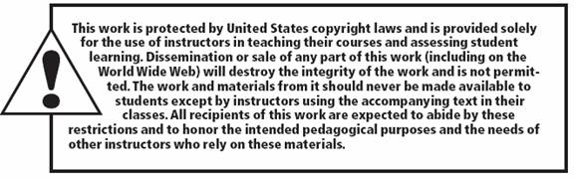
Copyright

